Slide 1

CONSTRUCTION
TAX LAWS​
CNMI PUBLIC LAW 23-31
SAIPAN LOCAL LAW 23-24

Slide 2


introduction to public law no. 23-31​
Public Law 23-31 was signed into law on January 10, 2025
Public Law 23-31 is effective on January 16, 2025​
This law applies throughout the entire Commonwealth of the Northern Mariana Islands (Saipan, Tinian, Rota)

Slide 3

WHAT DOES THIS LAW MANDATE?
Unless exempted, the law imposes a 3% surtax on the gross revenues of a General Contractor directly attributed to or derived from a Qualifying Construction Project. [Public Law 23-31 § 102(a)]

Slide 4
CNMI PUBLIC LAW 23-31 APPLIES TO -
A General Contractor. A General contractor means the primary entity that contracts for the completion of the entire construction project. [PL 23-31 §101 (a)]
The gross revenues which are derived from a qualifying construction project. A Qualifying Construction Project is defined as a construction project, other than construction of residential housing, with a total construction cost of $350,000.00 or more. [PL 23-31 §101(b)]
Any and all Qualifying Construction Projects awarded or executed on or after January 16, 2025. Any non-qualifying contract prior to January 16, 2025, which later met the QCP threshold ($350,000.00) due to a change order or modification on or after January 16, 2025.​ [PL 23-31 §102 (d)]

Slide 5
CNMI PUBLIC LAW 23-31 DOES NOT APPLY TO -
A Qualifying Construction Project contract awarded before January 16, 2025. [§102(d)]
A Subcontractors [PL 23-31 §101(d), and §102(c)]
Construction of Residential Housings. Residential Housing is defined as single family homes or other standalone dwellings designed for individual households. It does not include multi-family units such as apartments, condominium complexes, commercial residential developments, or other similarly shared living structures. [PL 23-31 §101(c)]

Slide 6

Monthly filing requirements
Applicable Tax Form – Form OS 3500CT
(Monthly Qualified Construction and Saipan Senatorial Construction Tax Return)
Filing Deadline – on or before the last day of the month, following the close of each month.
Returns for the Months of Jan-Mar 2025
must be filed by June 2. Penalties and
Interest will be imposed for these
months if filed after June 2, 2025.

Slide 7
Exercise 1:
Example 1: Company A, general contractor, was awarded a contract to construct a road. Contract amount is $1,000,000.00 executed and signed on January 30, 2025. Company A subcontracted Company B for $500,000.00.
Question 1: Which contract is considered as a Qualifying Construction Project?
Answer (a): Both Company A and B are Qualifying Construction Projects.
Question 2 : Which company from Ex. 1 is subject the 3% tax?
Answer (a): Company A is subject to 3% tax of the gross revenue, received or accrued, on the $1,000,000.00 because the contract cost exceeds $350,000.00 QCP threshold amount.
Answer (b): Company B, subcontractor, is exempt from the 3% tax.
Example 2: Same facts as Example 1, except the contract was executed and signed on January 15, 2025.
Question 1: Which company from Ex. 2 is subject to the 3% tax?
Answer (a): Company A is NOT subject to 3% tax because the contract was executed before January 16, 2025.
Answer (b): Company B, subcontractor, is exempt from the 3% tax.

Slide 8
Illustration of Example 1 - FACT 1
CNMI Public Law 23-31 | Company A | Company B
Gross Revenue, received or accrued | $1,000,000.00 | $500,000.00
Amount subject to 3% tax * | $1,000,000.00 | 0
Construction Tax at 3% | $30,000.00 | 0
*Assuming the whole contract amount was fully
received/accrued by the end of the year

Slide 9
Exercise 2
Example 3: Company C, general contractor has 3 different construction projects executed on different dates.
Project 1 cost at $250,000.00 contract executed on January 31, 2025
Project 2 cost at $350,000.00 contract executed on December 31, 2024
Project 3 cost at $450,000.00 contract executed on February 28, 2025
Question 1: Which Project in Ex:3 is considered a Qualifying Construction Project (QCP)?
Answer: Project 2 and 3 are considered as Qualifying Construction Projects because they both meet the QCP threshold ($350,000.00). Project 1 is not a QCP because the contract amount does not meet the QCP threshold ($350,000.00).
Question 2: Which Project is subject to 3% tax?
Answer: Project 3 is subject to 3% tax. Project 1 does not fall under the QCP threshold ($350,000.00) while Project 2 was executed before January 16, 2025. Therefore, both Project 1 and Project 2 are not subject to 3% tax.

Slide 10
Illustration of Exercise 2 – Quest 2
CNMI Public Law 23-31 | Project 1 | Project 2 | Project 3
Gross revenue, accrued or received | $250,000.00 | $350,000.00 | $450,000.00
Amount subject to 3% tax * | 0 | 0 | $450,000.00
Construction Tax at 3% | 0 | 0 | $13,500.00
*Assuming the whole contract amount was fully
received/accrued by the end of the year

Slide 11
Exercise 3
Example 4: Company D, general contractor, was awarded a $250,000.00 contract on December 31, 2024.
    On March 01, 2025, a change order in the amount of $150,000.00 increased the contract amount to $400,000.00.
Question 1: Is the original contract, executed on December 31, 2024, a Qualifying Construction Project (QCP)?
Answer: No. The original contract is not a Qualifying Construction Project because the contract amount is less than the QCP threshold ($350,000.00).
Question 2: Does the change order dated March 1, 2025, meet the criteria to classify the project as a Qualifying Construction Project?
Answer: Yes. Company D's project is considered a Qualifying Construction Project beginning March 1, 2025, and therefore, subject to 3% tax.
Question 3: What portion of the contract is subject to 3% tax?
Answer: All gross revenue, received or accrued beginning March 01, 2025, is subject to 3% tax.

Slide 12
Illustration of Exercise 3 – Ex 4
CNMI Public Law 23-31 | Original Contract | Change Order
Gross Revenue, received or accrued | $250,000.00 | $150,000.00
Amount subject to 3% tax * | 0 | $150,000.00
Construction Tax at 3% | 0 | $4,500.00
*Assuming the original contract amount was fully received or accrued before March 1, 2025. Therefore, only $150,000.00 is subject to 3%.

Slide 13


Slide 14
introduction to
SAIPAN LOCAL LAW 23-24​
Saipan Local Law 23-24 was signed into law on January 10, 2025
SLL 23-24 is effective on January 10, 2025
This law applies to Saipan only (Tinian and Rota are excluded)

Slide 15
WHAT DOES THIS LAW MANDATE?
Unless exempted, the law imposes an additional 1% tax on the yearly gross revenue derived from constructions activities, not including residential construction, in excess of Three Hundred Fifty Thousand Dollars ($350,000).

Slide 16
SAIPAN LOCAL LAW APPLIES TO -
Annual Gross Revenue of construction activities in excess of Three Hundred Fifty Thousand Dollars ($350,000.00). [ SLL §101(a)]
Gross Revenue from prior construction activities with change orders occurring after the effective date of this act. [SLL 23-24 § 101(c)]
General contractors and subcontractors.

Slide 17
SAIPAN LOCAL LAW DOES NOT APPLY TO -
Gross revenue generated by or derived from Residential Housing construction activities.
Construction activities with annual gross revenue less than Three Hundred Fifty Thousand Dollars ($350,000.00).
Revenues unrelated to construction activities.
Revenues from construction activities or construction projects engaged in prior to the effective date of this act .

Slide 18
Monthly filing requirements
Applicable Tax Form – Form OS 3500CT
(Monthly Qualified Construction and Saipan Senatorial Construction Tax Return)
Filing Deadline – on or before the last day of the month, following the close of each month.
Returns for the Months of Jan-Mar 2025
must be filed by June 2. Penalties and
Interest will be imposed for these
months if filed after June 2, 2025.

Slide 19
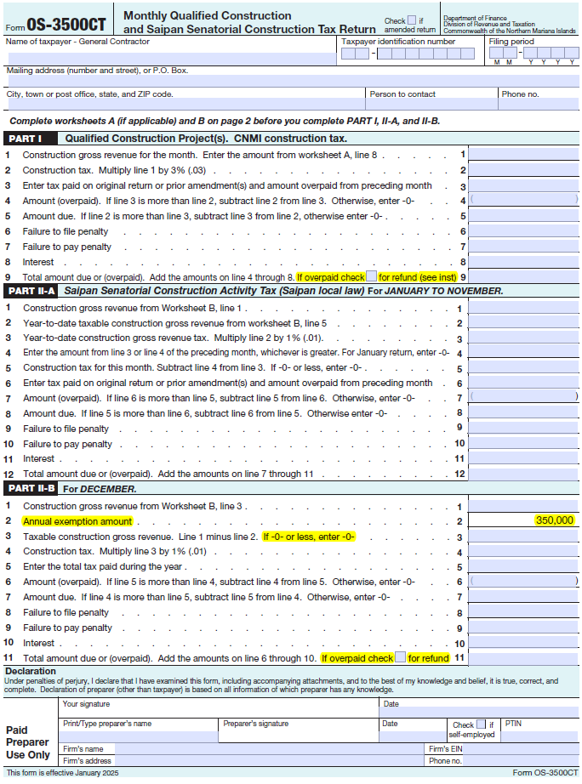
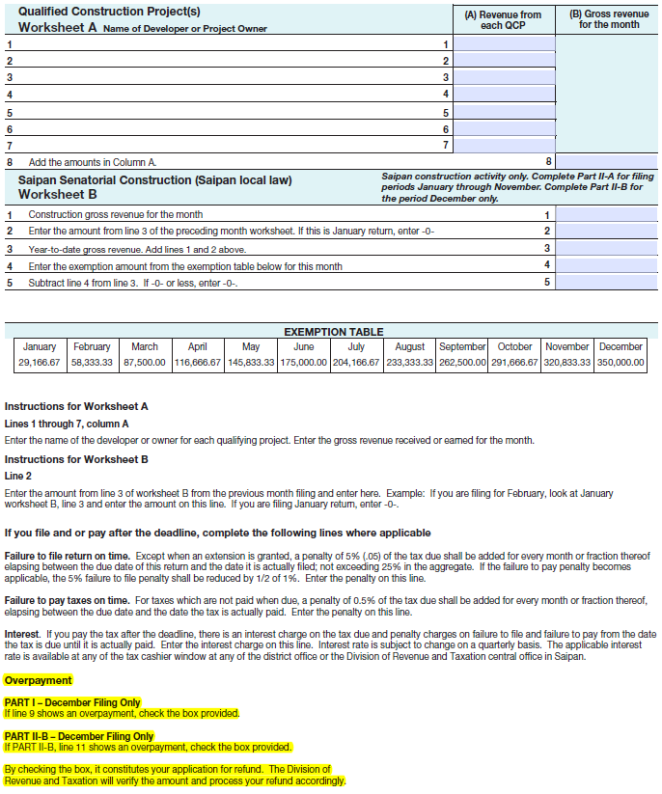

Slide 20
Example 1
fact 1: Company A, general contractor, received or accrued revenue for a road construction contract in the amount of $1,000,000.00. Company A subcontracted Company B for $500,000.00.
Question 1 : Which company from Ex 1 is subject to the 1% tax?
Answer (a): Company A is subject to 1% tax on the portion of its annual gross revenue that exceeds $350,000.00. In this case, $650,000.00 is subject to 1% tax.
Answer (b): Company B is also subject to 1% tax on the portion of its annual gross revenue that exceeds $350,000.00. In this case, In this case, $150,000.00 is subject to 1% tax.

Slide 21
Illustration of Example 1 – fact 1
Saipan Local Law 23-24 | Company A | Company B
Gross Revenue, received or accrued | $1,000,000.00 | $500,000.00
Exclusion for the year | ($350,000.00) | ($350,000.00)
Amount subject to 1% tax * | $650,000.00 | $150,000.00
Construction Tax at 1% | $6,500.00 | $1,500.00
*Assuming the whole contract amount was fully
received/accrued by the end of the year

Slide 22
Example 2
Fact 2: General Contractor C recognized the following gross revenue from different construction activities, all in February, 2025.
  Gross revenue, accrued or received, from residential housing construction- $250,000.00
  Gross revenue, accrued or received, from road construction - $350,000.00
  Gross revenue, accrued or received, from commercial building construction - $450,000.00
Total Gross revenue for the year $1,050,000.00
Question 1: Which construction activities from Fact 2 are subject to 1% tax?
Answer: Gross revenue derived from road construction and commercial building construction are subject to 1% tax. Gross revenue derived from residential housing construction is exempt from the 1% tax.
Question 2: What portion of gross revenue, received or accrued, is subject to 1% tax?
Answer: All gross revenue, received or accrued, derived from non-residential construction activities totaling $800,000.00 ($350,000.00 plus $450,000.00) exceeding the $350,000.00 threshold is subject to 1% tax. In this case, $450,000.00 is taxed at 1%.

Slide 23
Illustration of Example 2 – fact 2
Saipan Local Law 23-24 | Company C
Gross Revenue, received or accrued | $800,000.00
Exclusion for the year | ($350,000.00)
Amount subject to 1% tax * | $450,000.00
Construction Tax at 1% | $4,500.00
*Assuming the whole contract amount was fully
received/accrued by the end of the year

Slide 25

FREQUENTLY ASKED QUESTIONS
What is CNMI Public Law 23-31?
CNMI Public Law 23-31 is a construction law which was signed on January 10, 2025, and effective on January 16, 2025, mandating to impose a 3% surtax on gross revenue derived from non-residential construction projects that cost Three Hundred Fifty Thousand Dollars ($350,000.00) or more.
What is a Qualifying Construction Project?
Qualifying Construction Project means any construction project, other than construction of Residential Housing, with a total project cost of Three Hundred Fifty Thousand Dollars ($350,000.00) or more, inclusive of executed change orders, amendments, and modifications.
What is a General Contractor?
General Contractor means the primary entity that contracts for the completion of an entire construction project and is typically responsible for the hiring and coordinating the work of subcontractors.

Slide 26
FREQUENTLY ASKED QUESTIONS
What is a Subcontractor?
Subcontractor means a person or company hired by a General Contractor to perform tasks or services as part of a larger construction project. Subcontractors operate under a separate contract from the one between the General Contractor and the client.
Are Subcontractors subject to 3% tax?
No. Revenues of a Subcontractor that are derived from construction activities performed on a Qualifying Construction Project are exempt from the tax imposed by CNMI Public Law 23-31.
Is CNMI Public Law 23-31 applicable to ongoing construction projects awarded prior to January 16, 2025?
No. CNMI Public Law 23-31 (3% surtax) does NOT apply to contracts initiated and executed on or before January 15, 2025.

Slide 27
FREQUENTLY ASKED QUESTIONS
What is Saipan Local Law 23-24?
Saipan Local Law 23-24 is a construction law which was signed on January 10, 2025 and effective immediately, mandating to impose a 1% tax on yearly gross revenue of construction activities in excess of Three Hundred Fifty Thousand Dollars ($350,000.00).
Are Gross Revenue from Residential Housing Construction Activities subject to 1% tax?
No. The yearly gross revenue tax shall exclude construction activity gross revenue generated by or derived from residential housing construction activities that is intended primarily of living purposes.
What is a Residential Housing?
Residential Housing under this Act shall mean construction of individual homes and not apartments or similar activities.

Slide 28
FREQUENTLY ASKED QUESTIONS
Is Saipan Local Law 23-24 applicable to constructions projects prior to January 10, 2025?
No. Revenues from construction activities for construction projects engaged in prior to the effective date are exempt to 1% tax.

Slide 29

EXERCISES
(AUDIENCE PARTICIPATION)

Slide 30
EXERCISE SCENARIO
Company E, a construction company in the CNMI was awarded a contract on January 10, 2025, for $1,000,000.00 to build a park. The company would oversee the entire project from inception to completion. Company E then subcontracted a portion ($250,000)of the project to Company F. On February 8, 2025, a change order was executed, bringing the contract total amount to $1,500,000.00
CNMI Public Law 23-31 and Saipan Local Law 23-24

Slide 31
Exercise Question No. 1
Does Company E meet the definition of a General Contractor?​

Slide 32
Exercise Question No. 2
Is the Project awarded to Company E, a Qualifying Contruction Project (QCP)?​

Slide 33
Exercise Question No. 3
Which Company would be subject to the 3% tax?

Slide 34
Exercise Question No. 4
Which company would be subject to the 1% tax?

Slide 35
Exercise Question No. 6
After the change order, is any company subject to 3% tax?

Slide 36
Exercise Question No. 7
After change order, is any company subject to the 1% tax?

Slide 37

TAKEAWAYS
We are able to identify two distinct construction-related tax laws.
We are able to define terms related to the construction tax laws.
We have identified the proper procedure for filing the relevant construction tax.

Slide 38

Prepared & Presented By:
Division of Revenue & Taxation​
​Examination Branch Team
    Melvina Litulumar​
    Jolene Demapan​
    Ofelia Pangelinan
    Rosalie Litulumar
    Marites Donahue
​

